Slide 1
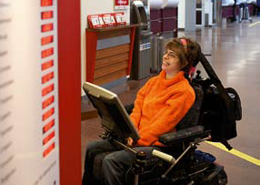
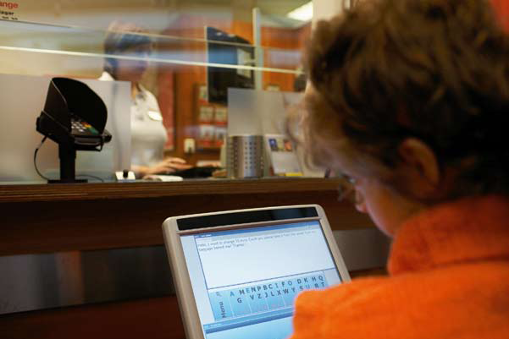
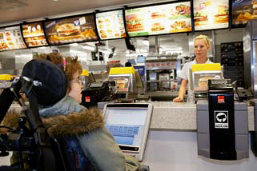
What does Kathrin Lemler think about using MyTobii to communicate using her eyes?
“Its magic! An indescribable feeling. I am a member of society. I can communicate. MyTobii is my voice”

Slide 2
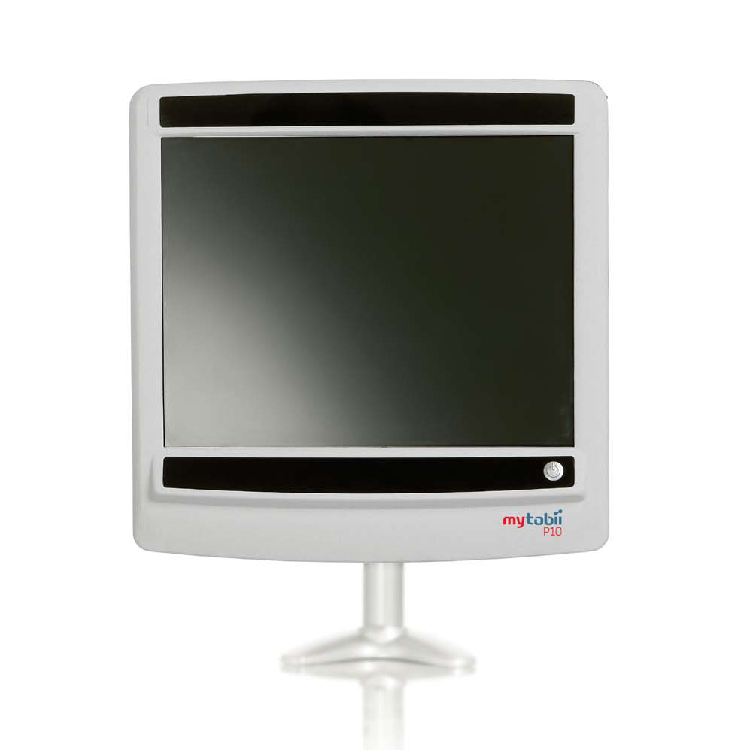
MyTobii Speech Generating Device
Why MyTobii?
Enables individuals to communicate using only their eyes.
Unique ability to deal with large head movement

Slide 3
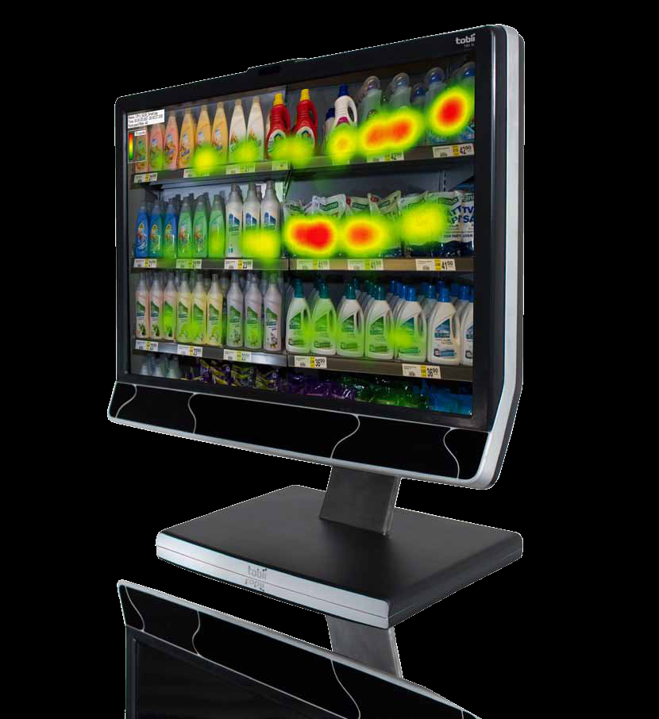
EYE Control Device

Slide 4
EYE Control Device

