Slide 1
General Education/Traditional Classroom
Theracare
Resource Room
SEIT
Self contained
Gifted & Talented
District 75
Home School
Inclusion

Slide 2

District 75
District 75 offers a variety of services to students citywide which includes;
Autism, severely emotional challenged, and/or multiply disabled
There is 56 school organization within district 75 which includes homes and hospital instruction, and vision and hearing services.
District 75 has over 350 sites citywide including Syosset.

Slide 3
Resource Room
Resource room are classroom and sometimes smaller classrooms that offers services to students with disability.
Students that qualify for resource room either qualifies for special classroom needs or regular classroom needs but needs special instructions in individualized or small group setting for a portion of the day.
Students that qualify for a resource room must have a IEP

Slide 4
Gifted and Talented
Gifted and Talented are district based and can begin as early as kindergarten.
There are three citywide gifted and talented schools that accepts students from all five boroughs.
The DOE offers self contained classroom model in which the gifted receives appropriate instruction for the day as a group.
The students receive variety of enrichment and acceleration experience to meet their needs.
The curriculum is modified to meet their needs.

Slide 5
Special Education Itinerant Teacher (SEIT)
Who does SEIT Serve
Speech/language delays
Behavior difficulties
Short attention span
Impulsivity
Low frustration tolerance
Cognitive delays
Motor delays.

Slide 6
Theracare
Provides developmental, educational, and evaluation services to children of ages from birth to five years
The company’s services include early intervention, preschool special education evaluation, special education itinerant teacher, contractual and related services, applied behavior analysis program, and nursing services

Slide 7
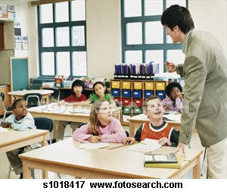
Inclusion
is a term that expresses a commitment to educate students with special education needs in the school he or she would attend if the student did not have a disability. It involves bringing support services to the student rather then removing the student to a separate environment to access needed services.

Slide 8
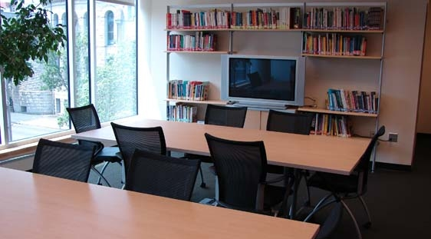
Resource Room
Classrooms where the special education program can delivered to a students disability.
Students who qualify for either a special class or regular class placement but needs some special instruction in an individualized or small group setting for a portion of the day.

Slide 9
Self Contained
A self-contained classroom is one in which the students share similar academic requirements. For example, all the gifted children in a school or school district will be contained in the same classroom.

Slide 10

Home School
Homeschooling or home school (also called home education or home learning) is the education of children at home, typically by parents but sometimes by tutors, rather than in a formal setting of public or private school.

Slide 11
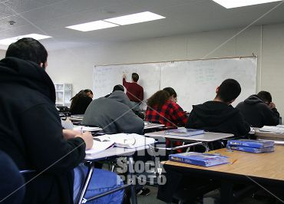
General Education
In this program, the child attends a general education class full-time, but receives services, such as speech therapy or occupational therapy, either in the classroom or outside of the classroom for a specified number of periods per week

