Slide 1
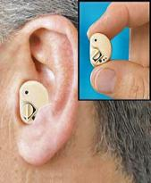
AmpliEar
Original and Ampli Ear Ultra
Finally: clarity, amplification, and comfort

Slide 2

Benefits of obtaining the Ampli-EAR
Improvement in the quality of life
Expand communication with relatives, friends, teachers, etc.
Eliminates isolation
Nearly invisible in ear (minimize embarrassing
moments.)
Hear the Quietest Whispers,
Listen to the FAINTEST cafeteria conversations,
CLEARLY hear conversations in a crowded classroom.
Watch TV with the volume turned down lower

Slide 3
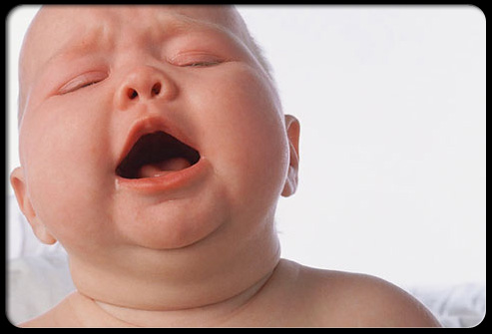
Symptom and Signs
Isolation
Lack of understanding
Moving closer to television
Excessive crying

Slide 4
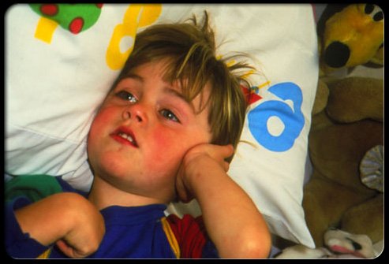
Consequences of Non-Treatment of Impairment
Numerous social and psychological problems.
Some hearing-impaired people also experience physical problems because of their hearing loss.
Lack of Understanding

Slide 5
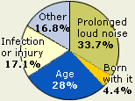
Causes of hearing loss/impairment
Most common causes:
Excessive exposure to noise.
Increasing use of portable CD players and MP3 players
Hearing loss may also occur as a result of disease, infections or drugs.
May be inherited or be a result of physical damage to the ears or serious injuries to the head.
Be Aware, so you can hear
The earlier detected , the better!!!!!!

Slide 6
Hearing aide users suffering from depression:
The NCOA survey found that, among hearing aid users:
14 percent who suffered from mild hearing loss and 22 percent who suffered from severe hearing loss felt sad or depressed for two weeks or more each year; the same figures among non-users of hearing aids were 23 percent and 30 percent, respectively.
Only 7 percent of hearing aid users with mild hearing loss and 12 percent with severe hearing loss had felt worried, tense or anxious for a month or more during the past year. The same figures for non-users were 12 percent and 17 percent, respectively.
Non-hearing aide users suffering from depression:
:

Slide 7
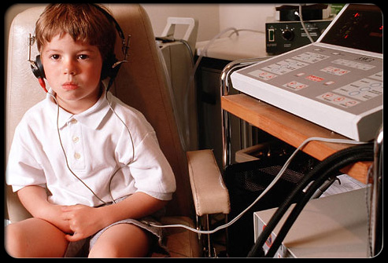
How do I began the first step of taking action to impair my hearing ability!!!!!!!
Step one
First and foremost, do research
Figure out what insurance will/ will not cover
Schedule an exam
Free Hearing Exam :
Receive a free hearing exam When you schedule an appointment online today
http://www.miracle-ear.com/centersearch.aspx?mode=1

Slide 8
References
Access to more and even more research
To purchase
Ampli ear:
www.Medicine.net
www.locateadoc.com/pictures/lynch-steven-8726.html
http://www.miracle-ear.com/centersearch.aspx?mode=1
Via 0nline:
www.shopdoe.com
www.hearing aid/2020.com
www.hear-it.org
Via- Telephone:
877-268-4264
Price Range: $ 29.99-$ 39.99
Usually covered by insurance.
Department of Education contract #

