Slide 1
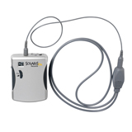
ASSISTIVE DEVICES
FM SYSTEMS
Erin M. Conte

Slide 2
What is an fm amplification system?
Frequency Modulated amplification system
Device used to transmit the teacher’s voice directly to the student at a steady level
Device used to ensure that a teacher’s voice is heard above all background noise, regardless of the location of the teacher

Slide 3
What students Might need an Fm Amplification system?
Students with a Hearing Disability (HI)
Students with Cochlear Implants (CI)

Slide 4
Why would these students need an fm amplification system?
Makes teacher’s voice more clearer than usual.
Helps overcome the aspects of noise, distance and echo, that a cochlear implant or hearing impairment might amplify

Slide 5

How does an FM AMPLIFIER work? …
Teacher wears the microphone approximately 8” from their mouth along with a transmitter
Student wears the receiver

Slide 6
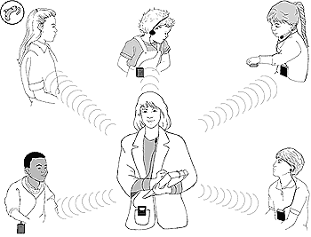
…Continued
When the teacher speaks, the transmitter changes the electrical signal from the microphone into an FM signal which gets sent to the students receiver
FM system must be set to the child’s individual listening settings

Slide 7

How much does an FM Amplification system cost?
The prices begins at $505.00!!

Slide 8
Where can I buy one?
Main Sales Address:
EnableMart Sales Office
c/o MRN, Inc.
5353 South 960 East
Suite 200
Salt Lake City, UT. 84117 - USA
Main Email:
sales@enablemart.com
Main Fax:
1-866-487-0410
Tax ID:
93-1287488
Main Phone:
888-640-1999

Slide 9
My Opinion
I have actually used this device in a classroom setting. It worked well as the student was able to hear my voice. I had one quam with it, I have a very loud, strong voice and could not remember to keep my voice at a low level in order not to hurt the child’s ear. A colleague told me she recently used an amplifier and was privately speaking to another teacher, when the students began to laugh. Apparently, she had forgotten to turn the sound off and consequentially the child heard all of the private conversation. I would advise another teacher to use this device as the student does benefit from its usage, however just make a conscious effort to remember that you have it on.

Slide 10
MY RESEARCH INFORMATION
www.phonicear.dk
www.boystownhospital.org/hearing/hearingaids/fmsystems.asp
www.enablemart.com

