Slide 1

School Placement Options By: Maria Di Lapi
General Education
Self Contained Classroom
General Education With Resource Support
One to One Teaching
Bi-Lingual Support
Home Schooling
Inclusion Classroom
Hospital School Setting

Slide 2
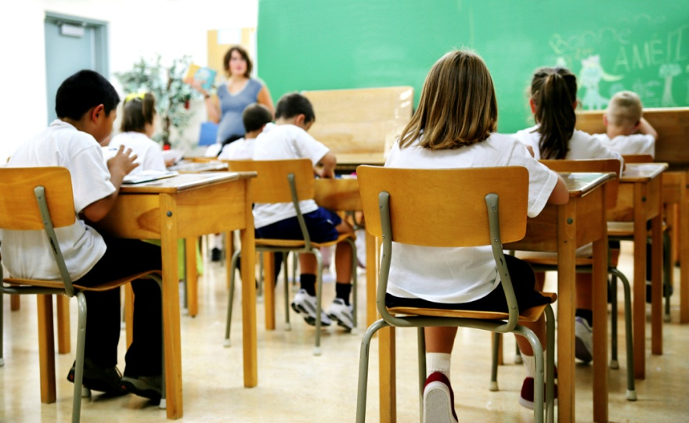
General Education
The students have class in a regular classroom with little or no support from outside resources. The class is led by a general education teacher. There are generally 25-30 students per class. The classroom is structured and has set routines.
Home

Slide 3
General Education With Resource Support
Students are seen in the resource room for remedial instruction in the area or areas in which the student qualifies for services. Some students may receive special education support from 1 to 2 and ½ hours per day. Generally in the resource room students come and go throughout the school day. These students sometimes have specialized needs such as ADHD.
Home

Slide 4

Bi-Lingual Support
Bilingual support is provided for students who speak English as their second language. These students are generally picked up by an ESL teacher for about an hour a day. They work in a small group setting with other students who speak English as their second language. This can help a student to become more fluent in the English language and therefore leading them to become better readers and writers.
Home

Slide 5
Self Contained Special Ed Room
A self contained special education classroom is a small controlled setting with a special education teacher. Students in a self contained classroom may be working at all different academic levels with different materials and curriculum. Generally there are about 10 students with unique struggles. This environment offers structure, routines and expectations.
Home

Slide 6

Inclusion
This environment is designed to have general education and special education students in one classroom learning together. This allows for positive effects on both types of learners. Students don’t feel secluded from everyone else which will increase self-esteem in students therefore leading to greater success!
Home

Slide 7
One to One Teaching
The student works one on one with the teacher. The student benefits from one to one teaching because it is an intimate environment. The teacher can closely monitor the child and adjust activities and lessons according to his or her needs. One to one also provides an opportunity to manage behavior if needed.
Home

Slide 8
Home School
Some families seek home schooling as a way to maintain strong connections with their child to have full control over the child's education. Other families need home schooling because their child has health conditions which makes it difficult for him or her to be transported to school everyday.
Home

Slide 9
Hospital Setting School
Provides year round educational services to school aged children while they are patients so they can continue their studies with little interruption. It is a safe and structured environment for all students. The students are able to work comfortably with little or no pain.
Home

