Slide 1
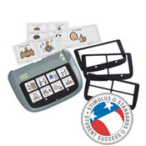
The Super Talker Progressive Communicator

Slide 2
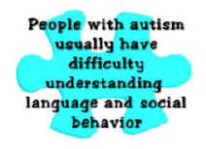
Who Uses This Device?
Autistic Children
Students reluctant to use their
Voice
Students who have difficulty expressing their needs

Slide 3
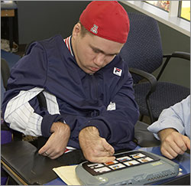
Benefits Of This Product
It is a portable assessment tool
16 minutes of recording time
8 levels of key messages
Eliminates the need to learn new devices as the student progresses
Allows the student to have choices
Encourages social interaction

Slide 4
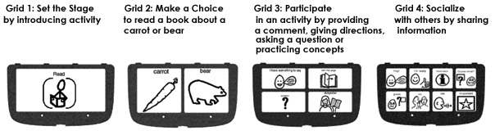
How It Works
As the student progresses the teacher snaps in a new grid and they can go up to 2 then 4 then 8 different output choices
The child can correlate the spoken word with the picture of the item

Slide 5
Cost

