Slide 1
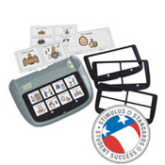
The Super Talker Progressive Communicator
By: Maria Di Lapi
EDUC 674
Professor Klein

Slide 2
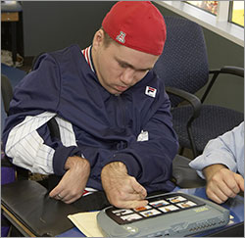
Who Uses This Device?
Autistic Children
Students reluctant to use their
voice
Students who have difficulty expressing their needs
Students with developmental language disorders
Students with severe physical disabilities

Slide 3
Benefits Of This Product
It is a portable speech generating
device
16 minutes of recording time
8 levels of key messages
Eliminates the need to learn new devices as the student progresses
Allows the student to have choices
Encourages social interaction
Crystal clear sound!
Runs on 4 AA batteries

Slide 4
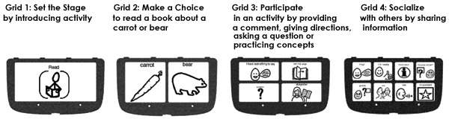
How It Works
Assists in the communication by playing back recorded messages upon activation
As the student progresses the teacher snaps in a new grid and they can go up to 2 then 4 then 8 different output choices
The child can correlate the spoken word with the picture of the item
Allows the user to access a sequence of messages

Slide 5
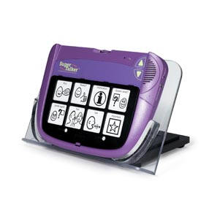
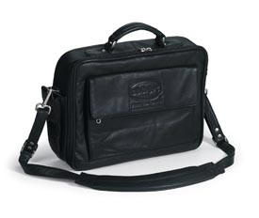
Cost
Super Talker Progressive Communicator $349.00
Adjustable Stand $167.00
Tote Bag $54.00

Slide 6
How to Purchase the Super Talker
WWW.ABLENETINC.COM
Also available through www.shopdoe.com
for $310.61!!!!

Slide 7

Recommendation
I would strongly recommend the Super Talker Progressive Communicator for a student who is not capable of verbal communication. The Super Talker is designed to grow with the student so the student does not have to keep learning new devices. It is compatible with the Boardmaker Program which is a very common program used in special education classrooms. It is not expensive and is available through the DOE website.
It is portable and can be used at home!
Before purchasing this product, parents and teachers should consider the literacy and fine motor skills the child has.

Slide 8
References
WWW.ABLENETINC.COM
WWW.MAYER-JOHNSON.COM
WWW.SHOPDOE.COM

