Slide 1
Art Class…
I Need…
I Want…
I Don’t…
Can you…
I would…

Slide 2





I Want…
HOME

Slide 3


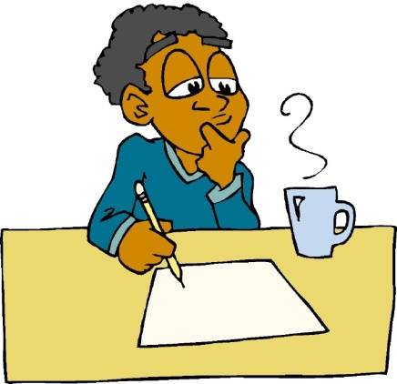
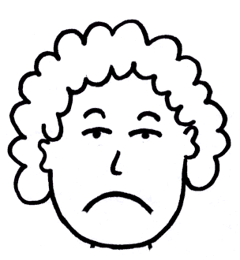
I Don’t…
HOME

Slide 4




I Need…
HOME

Slide 5



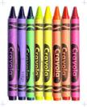
Can you…
HOME

Slide 6
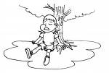


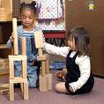
I would…
HOME

