Slide 1

Resources
General Education
Self Contained Classroom
Resource Room
Special Education Classroom
Bi-Lingual Program ESL
One to One Teaching
Inclusion Classroom
Residential School
Nothing is IMPOSSIBLE… When there are teachers!

Slide 2

General Education
The General Education classroom challenges students to develop values, skills, and mental awareness that are important to their success as a part of the population.
Home

Slide 3
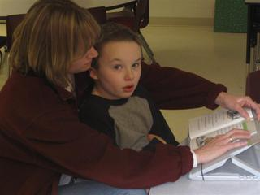
Resource Room (Pull-Out)
The Student has certain classes in the General Ed for the majority of the school day. When being pulled out to the resource room for particular subjects the students need extra help in, they are given extra academic support.
This program is to help students learn strategies and study skills to help them excel in the mainstream classroom.
Home

Slide 4
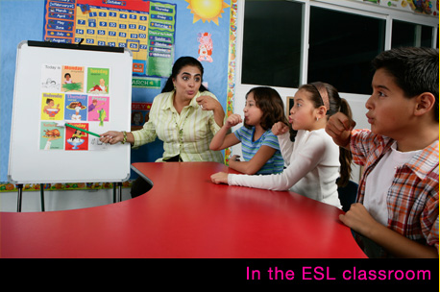
Bilingual Education Program (ESL)
ESL stands for English as a second language.
It states that a student has a native language that is not English.
The student learns the speech and language version of English with tools and strategies given by the teacher.
Home

Slide 5

Inclusion Classroom
Inclusion Education states that all students in a school become part of the school community even though they might have certain weaknesses in certain areas.
They feel together with all the students, teachers, and the school community.
IDEA has made it possible to educate students with disabilities in General Ed classrooms.
Home

Slide 6
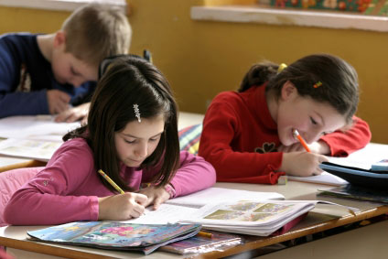
Self-Contained
A classroom where students share similar academic requirements. Such as, all gifted students in a school or school district will be held together in the same classroom.
Home

Slide 7
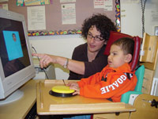
Special Education Classroom
In the Special Ed. Classroom the students are entitled to a set of services for students with disabilities who have the right to receive proper instruction to meet their individual needs.
It is specifically designed instruction based on individual needs, services, and supports.
Home

Slide 8
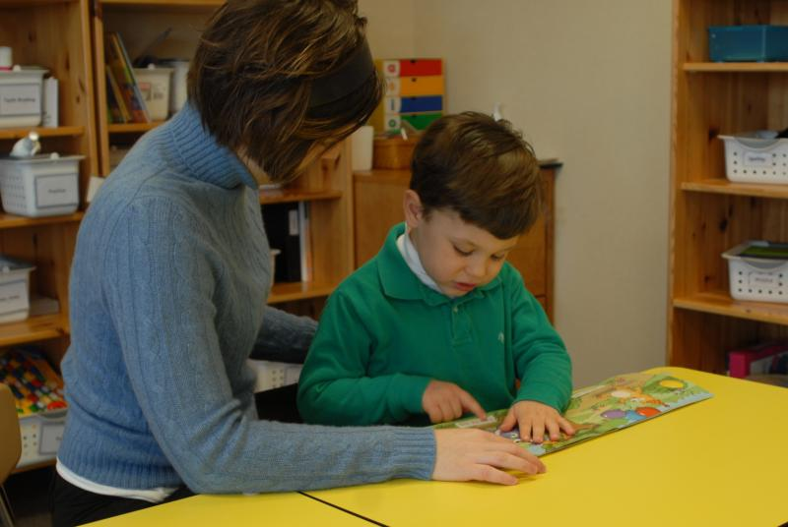
One to One Teaching
The student works directly with one teacher.
This gives the student direct instruction from the teacher, and because of the intimate environment the teacher can monitor how well the student is learning.
Home

Slide 9
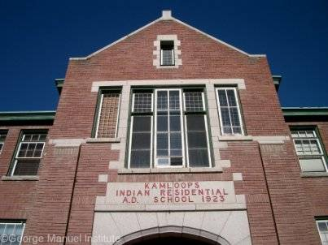
Residential School
This type of school is where not only do students learn, but the also reside during the semester.
These schools are usually for students with disabilities or behavioral issues.
Home

Slide 10
Resources
http://www.landoftheshuswap.com/msite/images/cgm66w.jpg
http://images.google.com/imgres?imgurl=ht
http://images.google.com/images?hl=en&um=1&sa=1&q=special+education+classroom&aq=f&oq=&aqi=g1&start=0
Home

