Slide 1
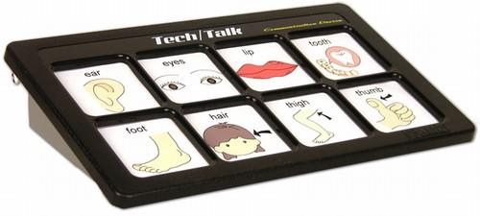
Assistive Technology for students with disabilities
AMDi Tech/Talk Communication Device

Slide 2
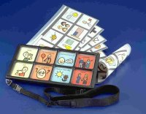
What does it do?
The AMDi Tech/Talk is an multi-level augmentative and alternative communication device designed to aid communication through direct selection.

Slide 3

Who is it for and how do they use it?
This device is use primarily by non verbal students with Autism.
Using the back of the machine students can change the dials to say different things at different volumes.
Using the red button the teacher can record new statements to correspond to new pictures on the front of the device.

Slide 4

What else can you tell me?
The device is light-weight and portable (shoulder strap included.)
It has a rear mounted volume and level controls .
There are external speaker.
You can switch the interchangeable overlays that can be easily created with Tech/Overlay Designer.
It records and playback 8 messages per level on a light-touch membrane pane.
l6, 8 or 12 levels for up to 96 independent messages.

Slide 5
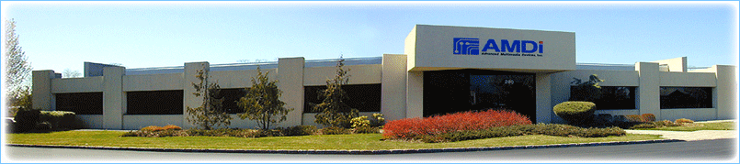
Who Makes AMDi Tech/Talk Communication Device
Advanced Multimedia Devices, Inc. is a U.S.-based corporation with its headquarters in Farmingdale, NY. AMDi focuses on the design, engineering, and manufacturing of high-quality and easy-to-use communication devices for special-needs customers.

Slide 6
Cost?
The cost varies depending on the model purchased. The price range is between $435 to $1070.
Levels | Standard |  | Extended Time |  | Standard with Jacks |  | Extended Time with Jacks
6 Levels | TT6x8BG | $435 | TT6x8BGEX | $705 | TT6x8BGJ | $525 | TT6x8BGEXJ | $795
8 Levels | TT8x8BG | $490 | TT8X8BGEX | $760 | TT8x8BGJ | $580 | TT8x8BGEXJ | $850
12 Levels | TT12x8BG | $710 | TT12X8BGEX | $980 | TT12x8BGJ | $800 | TT12x8BGEXJ | $1,070

Slide 7

Recommendation
I would recommend the Tech/Talk for lower level students who would use 8-16 phrases and need larger buttons because of poor fine motor skills.
However, I would not recommend this device for higher functioning students. If the student does not need large button areas and plan on using more than 16 phrases, I would suggest the Go Talk 20.

